Slide 1
CS5351 Software Engineering 2025-2026 Semester A Software Process Model
Dr W.K. Chan
Department of Computer Science
Email: wkchan@cityu.edu.hk
Website: http://www.cs.cityu.edu.hk/~wkchan

Slide 2
Motivation
A group of strong and committed programmers (say G = {Programmer A, Programmer B}) can hack on a code project to deliver an application to their users.
A knows the code P and its responsibility extremely well
B knows the code Q and its responsibility extremely well
A can deliver the code P, and B can deliver the code Q
A meets B’s needs on P; B meets A’s needs on Q
A and B can check with users U to get and verify the exact user requirements whenever necessary
A perfect case.

Slide 3
Motivation (in Reality)
A group of average, sometimes emotional, programmers (say G = {Programmer A, Programmer B}) can hack on a code project to deliver an application to their users.
A knows the code P and its responsibility gradually
B knows the code Q and its responsibility gradually
A can deliver a buggy P with incomplete functionality, and B can deliver a buggy Q with incomplete functionality
A may not know B’s exact needs on P; B may not know A’s exact needs on Q. As B only knows Q gradually, B’s requirement on P changes over time.
A and B can check with users U to get and verify the exact user requirements sometimes, but an old U resigns, and a replacement U comes! Some Us are inexperience in their business domain.

Slide 4
Motivation (For Larger Project In Reality) [1/3]
Suppose in Month 1, the group G = {Programmer A, Programmer B}
Month 2, G = {Programmer B}, A resigned.
Month 3, G = {Programmer A1, Programmer B}, A1 replaces A.
Month 4, G = {Programmer A1}, B resigned.
Month 5, G = {Programmer A1, Programmer B1}, B1 replaces B.
Month 6, G = {Programmer B1}, A1 resigned.
Month 7, G = {Programmer A2, Programmer B1}, A2 replaces A1.
Analysis
At Month 7, A2 gets the needs on code P via A⇒B ⇒A1 ⇒B1⇒A2
To what extent can A2 get what to be done, and what options have been tried on P?

Slide 5
Motivation (For Larger Project In Reality) [2/3]
A2 wishes to know
The requirement R that A collected from U (months ago!)
The latest changes in R before A2 takes up the position
The set of functions {f₁, …, f_{n}} of P that has been identified and designed but not been implemented (in full) with respect to the latest requirements
The feedback (from B or U) on the implemented functions {g₁,…,g_{m}} of P with respect to the latest requirements
Any known and critical issues in P but not completely fixed
B2 wishes to minimize his/her workload to pass on the information of P to A2
A1 also wishes to minimize the workload to pass info of Q to B2

Slide 6
Motivation (For Larger Project In Reality) [3/3]
U does not want A, A1, A2 and B, B1 to affect U’s daily jobs.
Entertaining these A/B is a side business only.
Can you expect an estate agent as U to meet with A-A2 and B-B1 instead of meeting with his/her clients (thus, no commissions are received, or a lower salary is the result)?
Everyone wishes to get quick references and move forwards
When a project is large, no one knows all the details of the whole project.
Waiting for clear instructions and clear task specifications before doing the task is unrealistic.

Slide 7
Needs
The software project scenario in the previous few slides needs a strategy to control the order of project tasks and the information flow to
reduce production overheads,
improve information passing efficiency,
give tractability from user expectation to delivery,
predict and track task/project completion and outstanding issues,
improve code quality,
track what has been agreed not to design or implement,
enable newcomers to be productive as soon as possible, and …
Otherwise….[next slide]

Slide 8
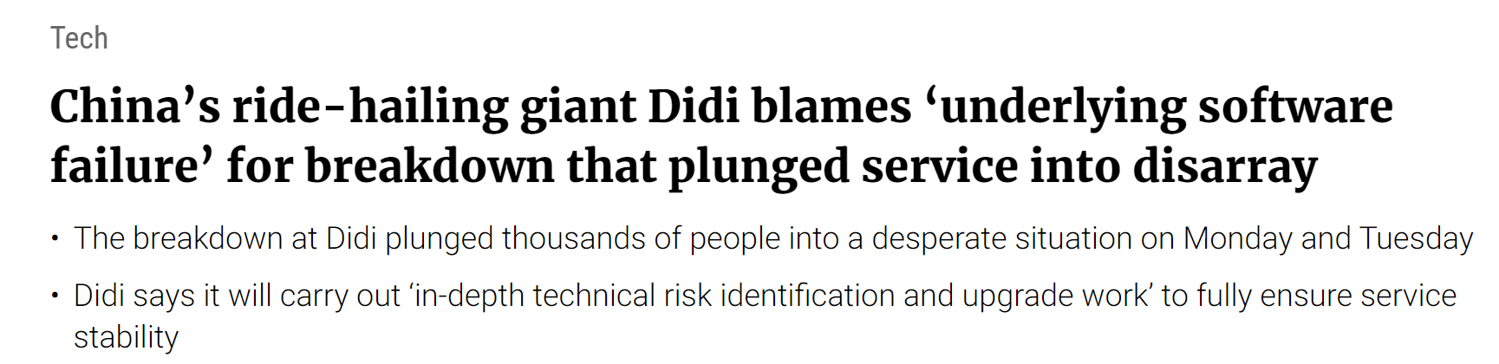
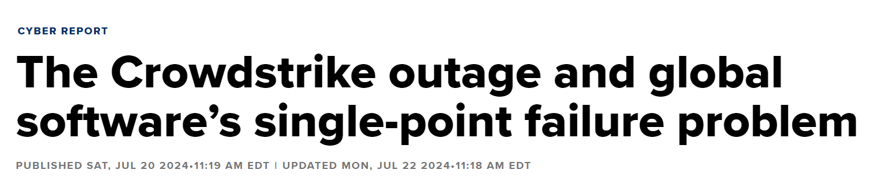
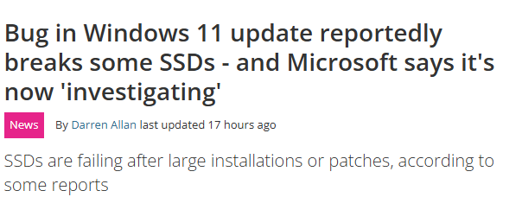
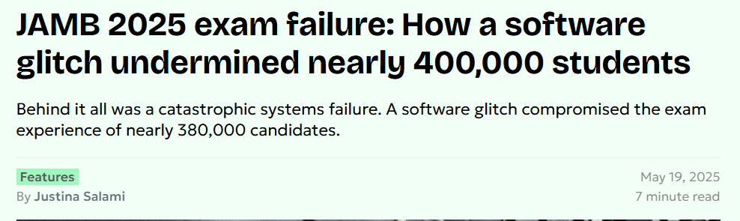
Bugs and Delays are Ubiquitous:

Slide 9
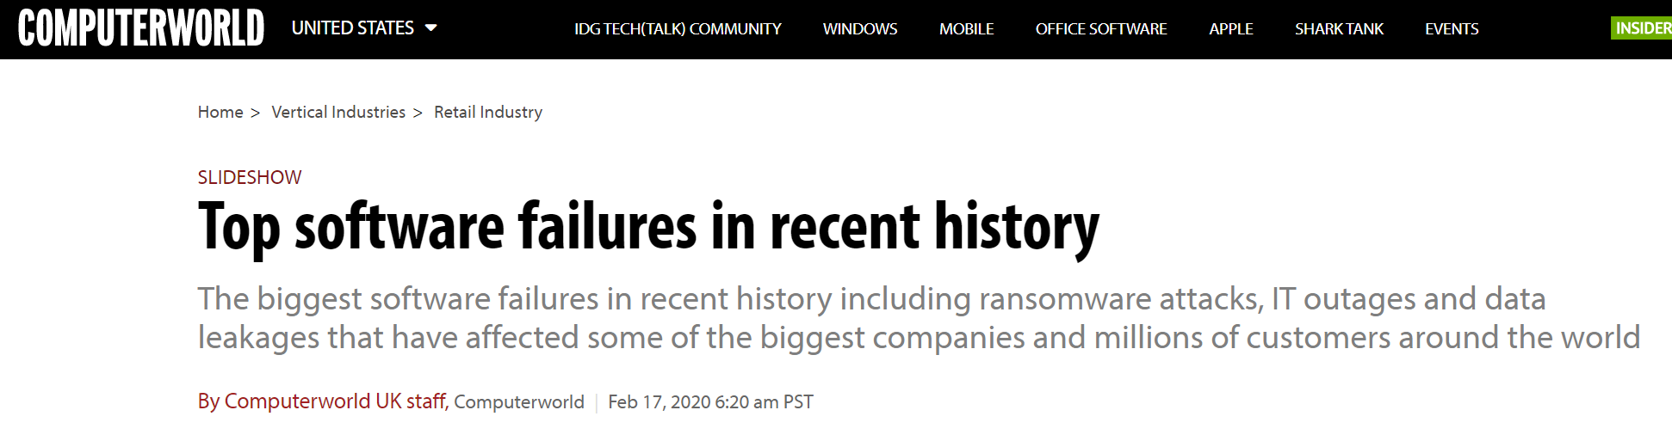
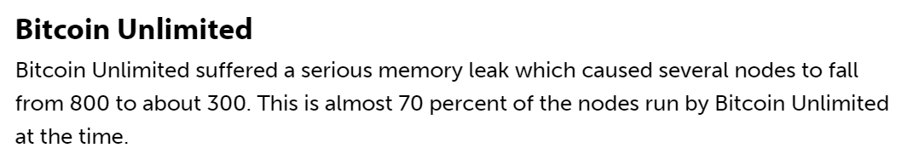
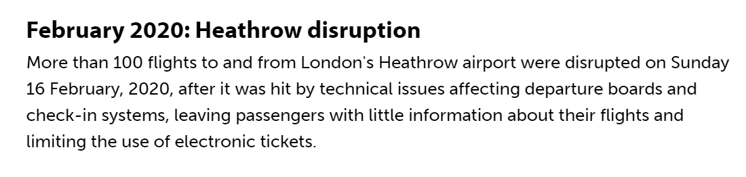
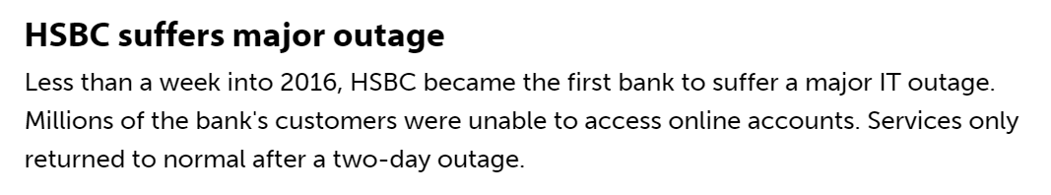
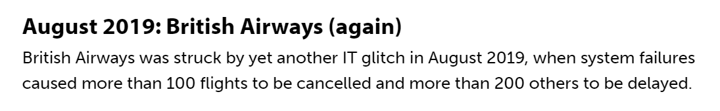

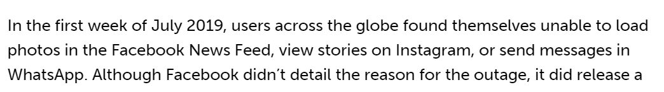
Bugs and Delays are Ubiquitous:

Slide 10

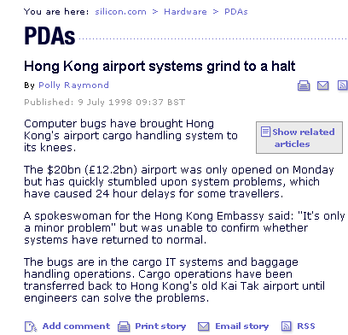
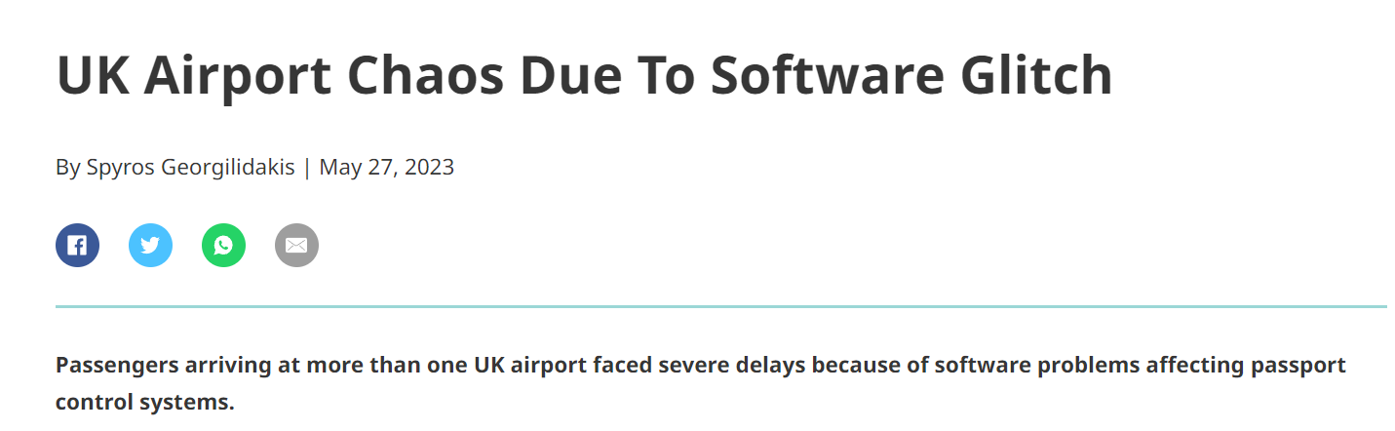
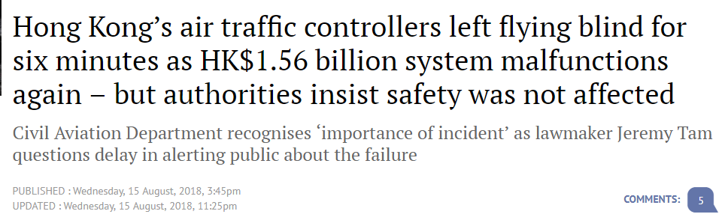
Bugs and Delays are Ubiquitous: Airport Chaos and System Upgrade
Hong Kong Airport
https://www.scmp.com

Slide 11
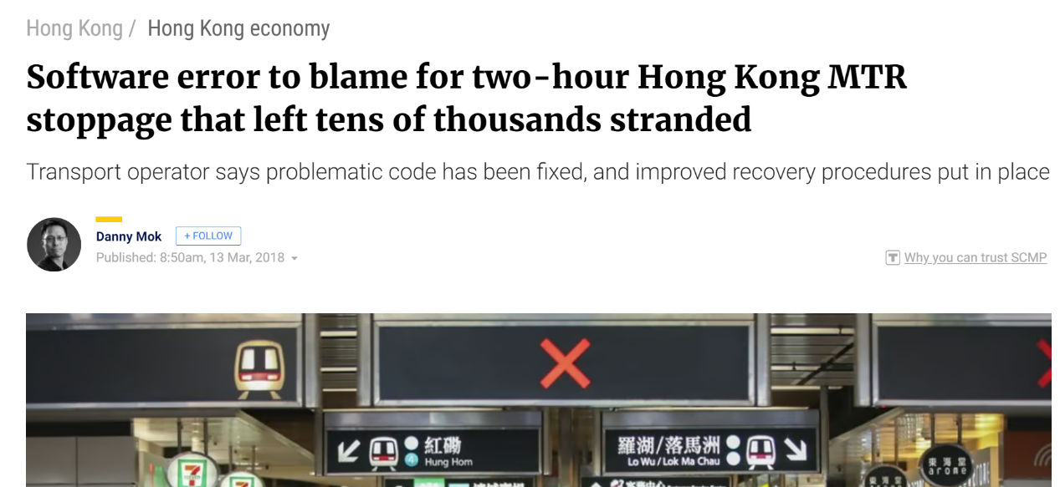
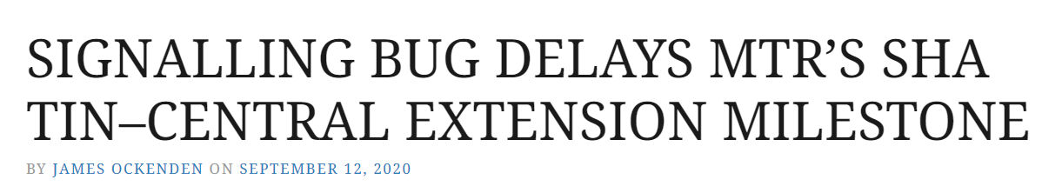
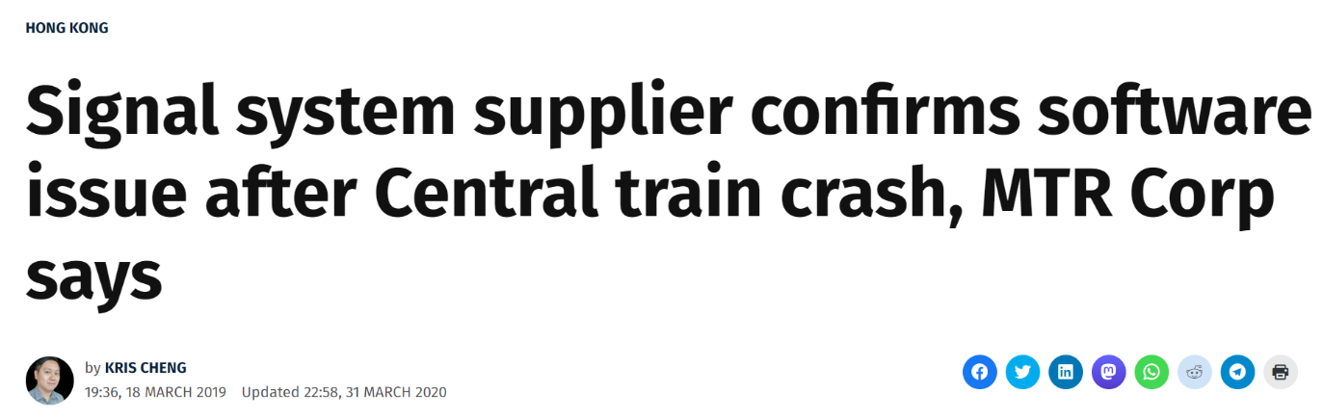

MTR

Slide 12
Facts (quite some years ago): Software Development Project
28%
49%
23%
cancelled before completion.
completed on time and within budget.
cost 89% more than their original budget
But, only 42% of the original requirements can be implemented.

Slide 13
Problems
Nothing can be useful or reused
from such cancelled projects?
How to identify a subset of requirements,
which are consistent among them, and track their development?
How to streamline the activities better to reduce cost?
Need to prioritize the requirements for guide the development effort

Slide 14
More Recent Findings: Better gradually
Standish Group’s Annual CHAOS 2020 report
66% of projects end in partial/total failure.
31% canceled; 53% with performance degrade
Large project: success rate 10%; Small project: success rate 90%
McKinsey in 2020
17% of large projects go badly
BCG (2020)
70% of digital transformation efforts fall short of meeting targets.
PMI (2024)
48% of projects qualified as successful, with 12% an outright failure and 40% with mixed views.

Slide 15
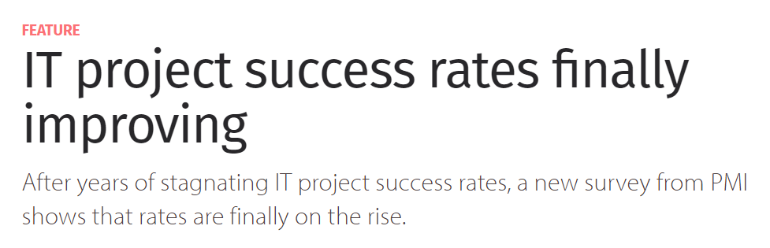
Recent Situation Project Failure in 2018
https://www.cio.com
“The PMI research also identifies a number of factors common to the Champion organizations, says Langley. Besides a focus on benefits realization, champion organizations are more likely to focus on project management talent, have at least one PMO [project management office] within their organization, drive executive sponsorship and use agile approaches to project management, the research revealed.” (2018)

Slide 16
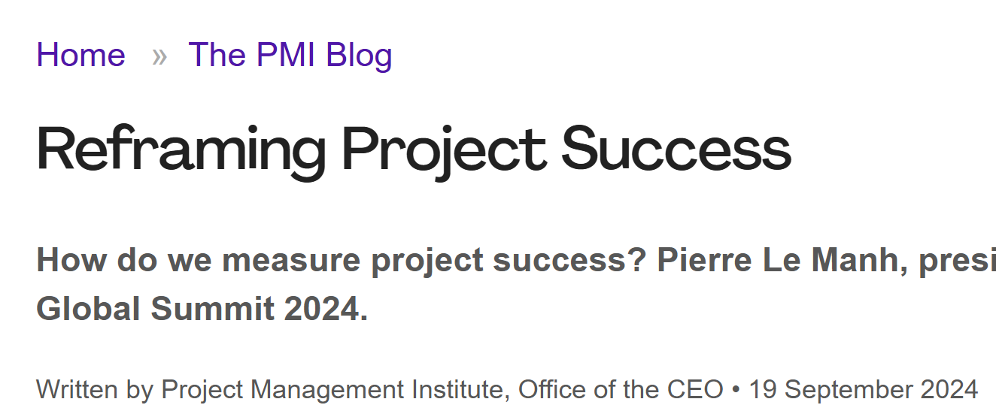
Recent Situation Project Success in 2024
“PMI identified three factors that contribute to achieving the maximum benefit:
Defining success criteria upfront (e.g., cost, schedule, scope, quality, and stakeholder satisfaction)
Putting a performance measurement system in place
Tracking performance throughout the project
Only 37% of all projects do all three of these things. Implementing all three factors nearly doubles the success compared to projects that have two or fewer of these factors.

Slide 17
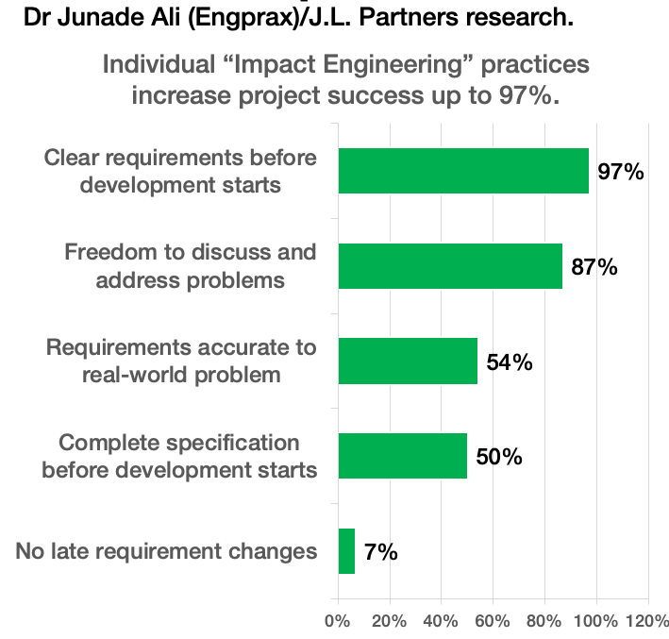
More Recent Findings
https://hbr.org/2023/10/its-time-to-end-the-battle-between-waterfall-and-agile
https://www.engprax.com/post/268-higher-failure-rates-for-agile-software-projects-study-finds
Harvard Business Review (2023)
A hybrid of waterfall and agile methods is better
Impact Engineering (2024)
65% of projects adopting Agile requirement engineering practices fail to deliver on time.
But if a more structural and “waterfall”-style requirement engineering practice is in place, the failure rate for on-time delivery is 10%.
Experimental (2025): AI-assisted PM

Slide 18
Software Engineering Process
A software engineering process model is a set of
(1) activities,
(2) techniques,
(3) deliverables and
(4) tools
so that software engineers and project managers follow
(5) best practices to use the items (1)−(4) to manage software systems

Slide 19
SE Process ⎯ Activities
Collecting user requirements
Designing software
Coding/Implementation
Testing
Deploying the software at user sites
Maintain software
Configuration Management
Project Management
Let’s recall what they are with examples on the next few slides.

Slide 20
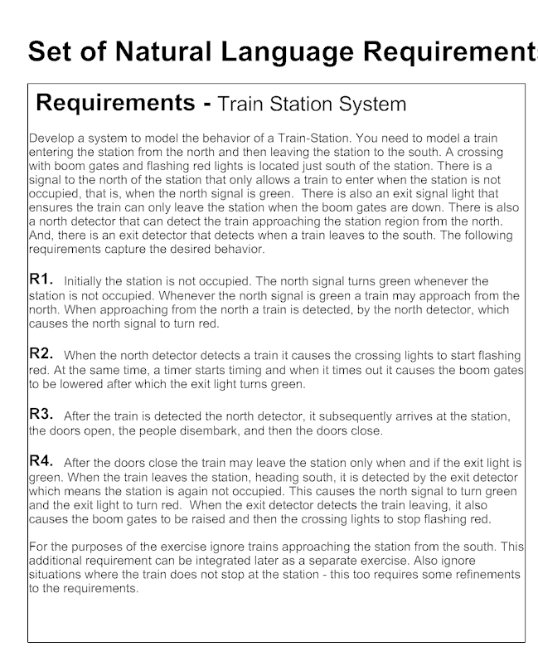
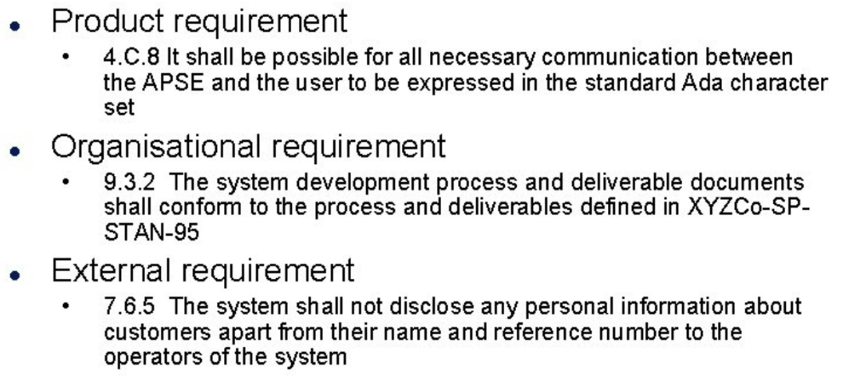
SE Process ⎯ Activities Exemplified Software Requirements
User Requirements
Non-functional Requirements

Slide 21
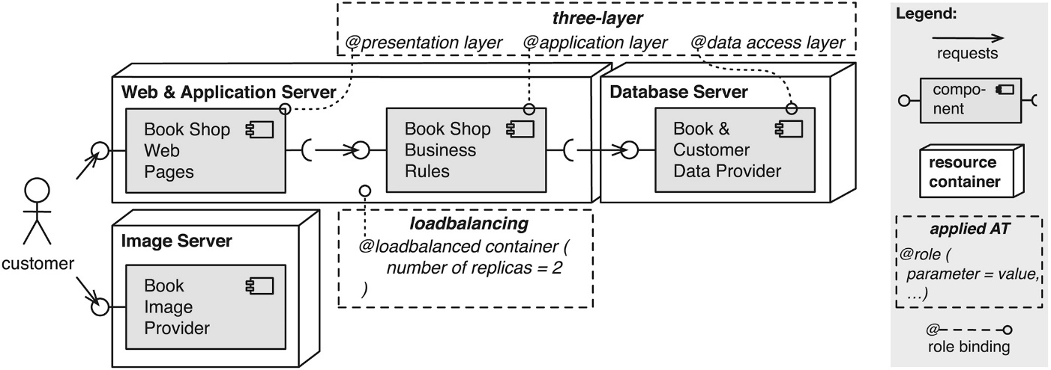
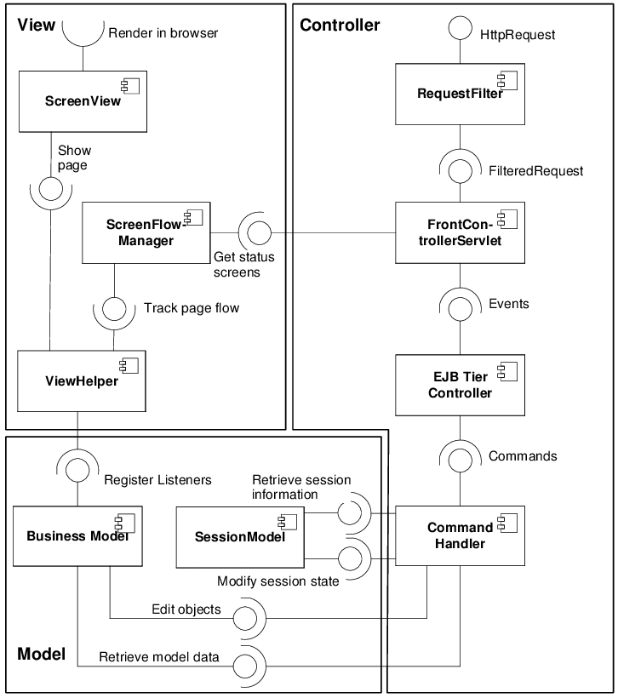
SE Process ⎯ Activities Exemplified Software Architecture
Notes:
Figure 4 of The architectural template method: templating architectural knowledge to efficiently conduct quality-of-service analyses
(SPE 2018 Feb issue, pages 268-299) https://onlinelibrary.wiley.com/doi/full/10.1002/spe.2517
A Comparison of Standard Compliant Ways to Define Domain Specific Languages (MODELS 2007)
International Conference on Model Driven Engineering Languages and Systems
MODELS 2007: Models in Software Engineering pp 47-58
https://link.springer.com/chapter/10.1007/978-3-540-69073-3_6

Slide 22
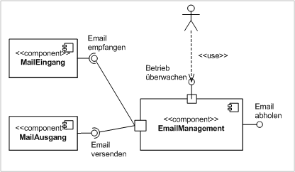
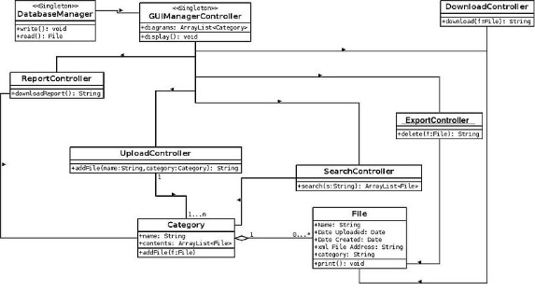
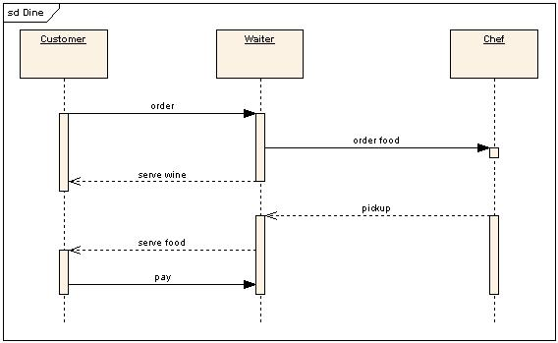
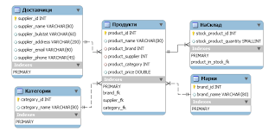
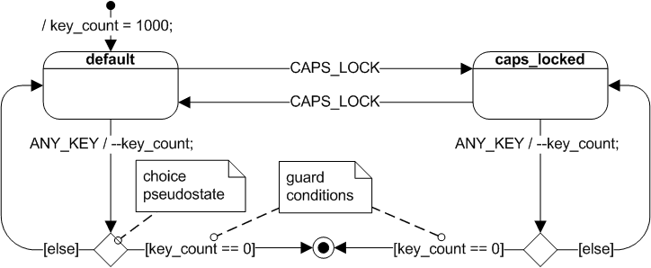
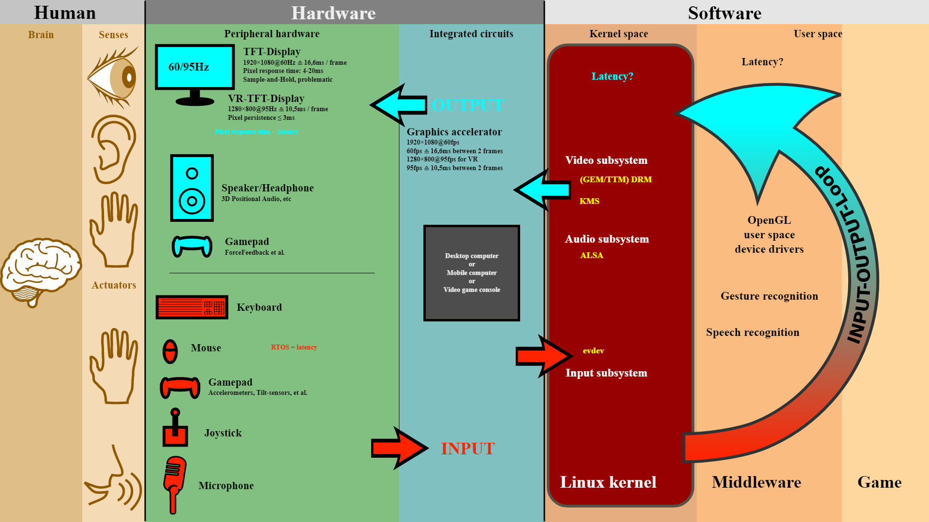
SE Process ⎯ Activities Exemplified Software Designs
Static view:
Component diagram
Dynamic view:
sequence diagram
Class diagram
Database scheme
User interface Design
State transition diagram

Slide 23
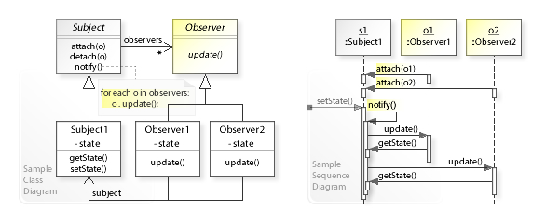
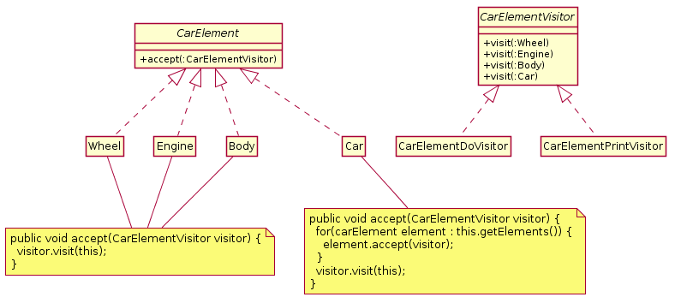
SE Process ⎯ Activities Exemplified Software Design Patterns
observer pattern
visitor pattern

Slide 24
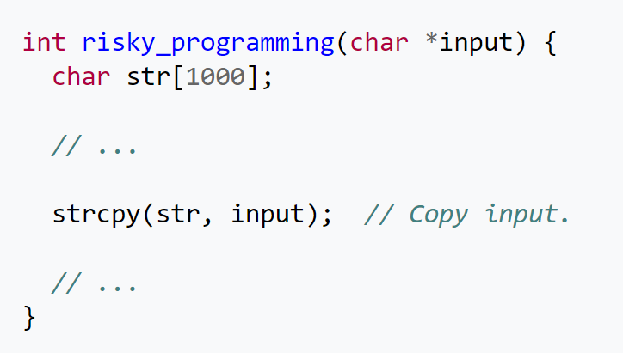
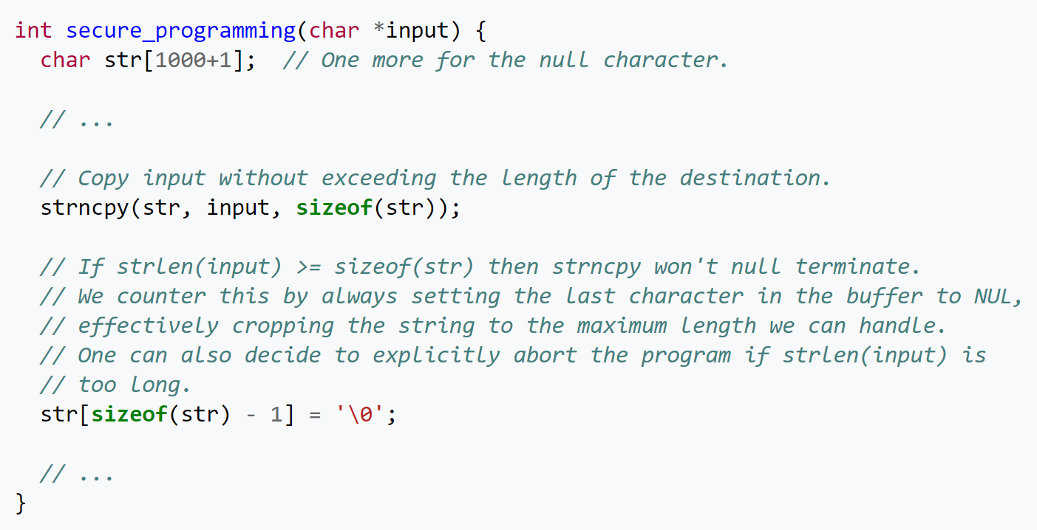
SE Process ⎯ Activities Exemplified Coding with Quality
better coding

Slide 25
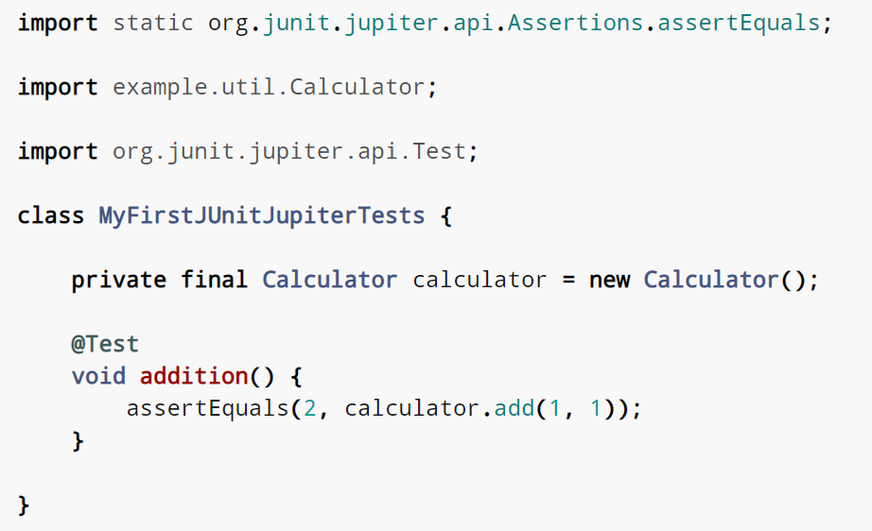
SE Process ⎯ Activities Exemplified Testing
Unit testing

Slide 26
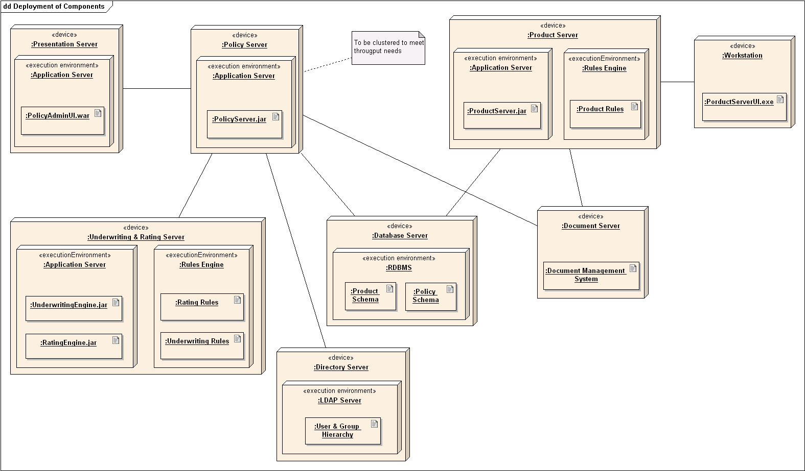
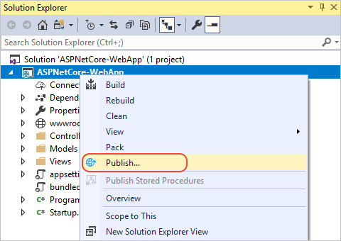
SE Process ⎯ Activities Exemplified Software Deployment
Deployment diagram: Map software component to run on
hardware device (or hardware virtualization)
Write scripts or use a tool to publish it

Slide 27
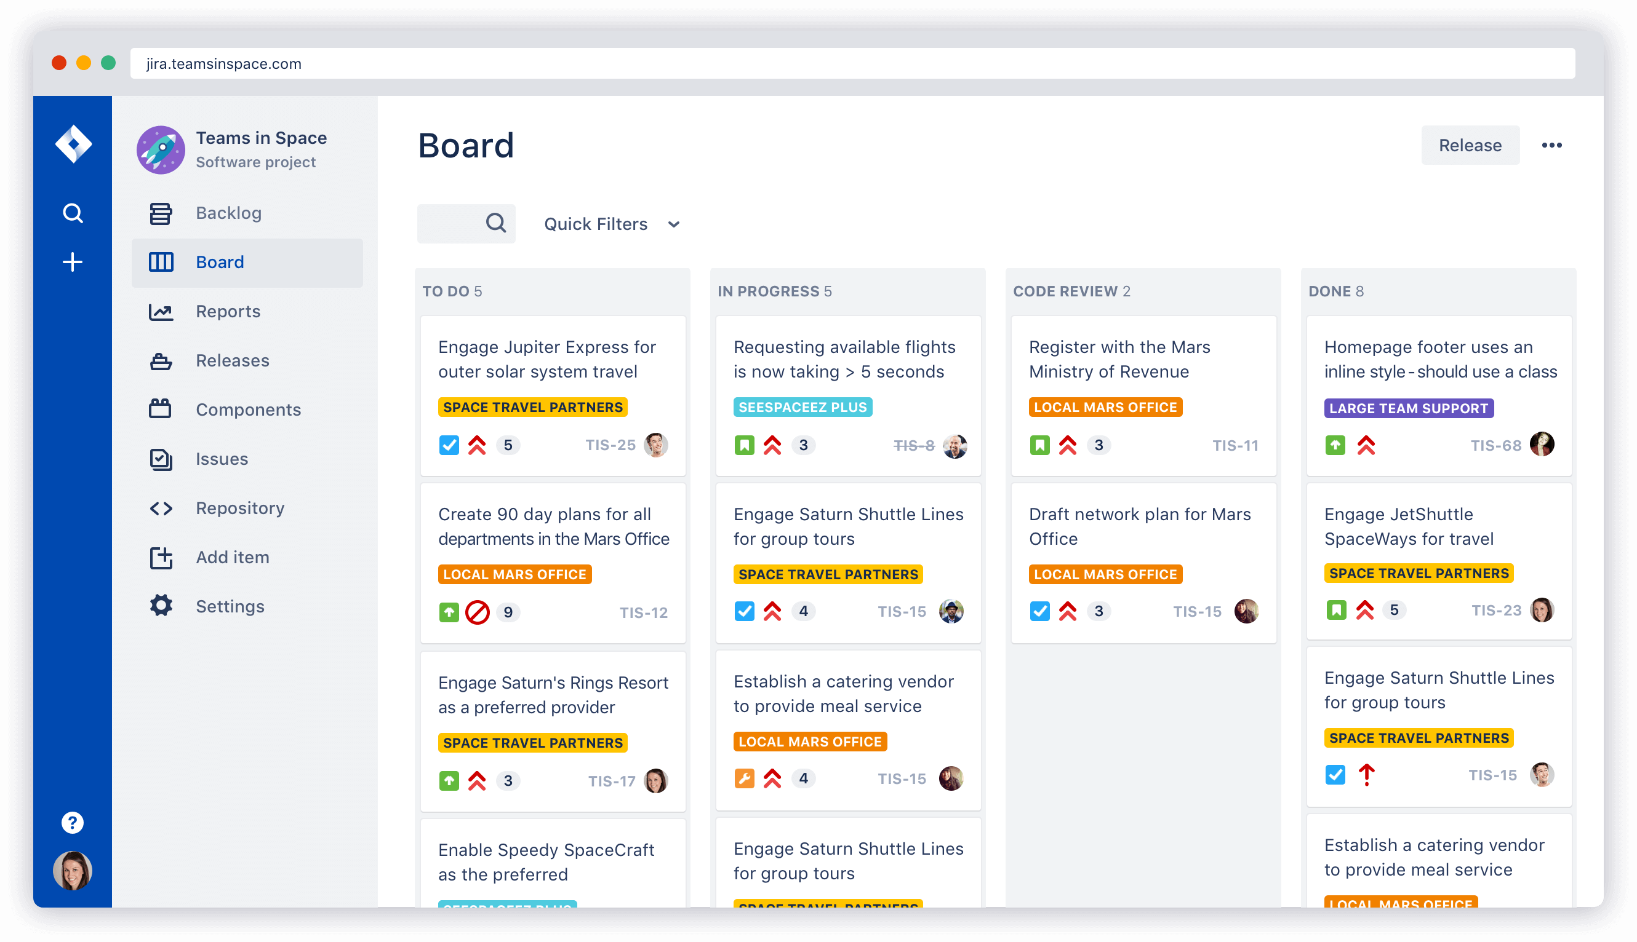
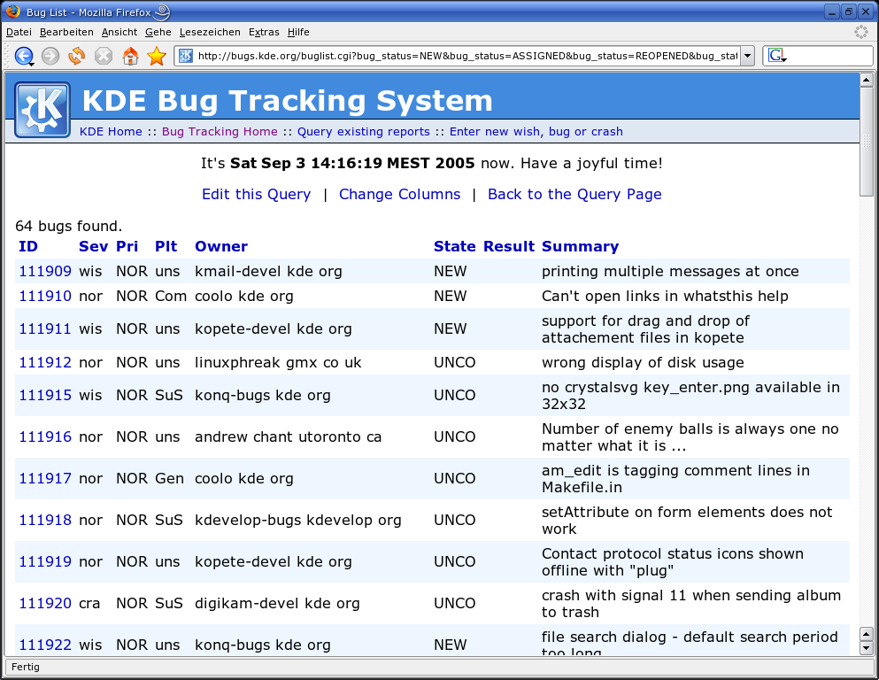
SE Process ⎯ Activities Exemplified Software Maintenance

Slide 28
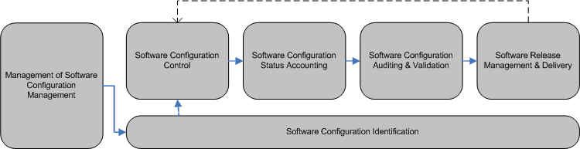
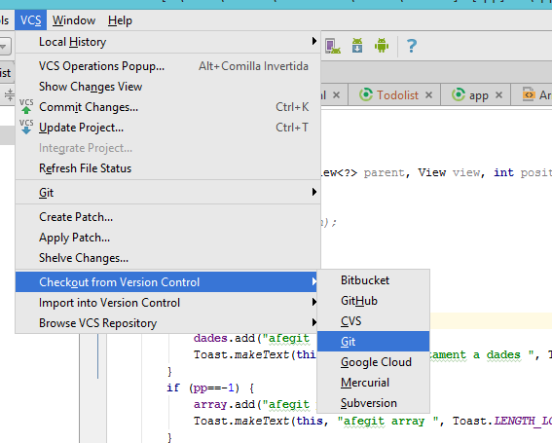
SE Process ⎯ Activities Exemplified Configuration Mgt
Process
Code version control

Slide 29
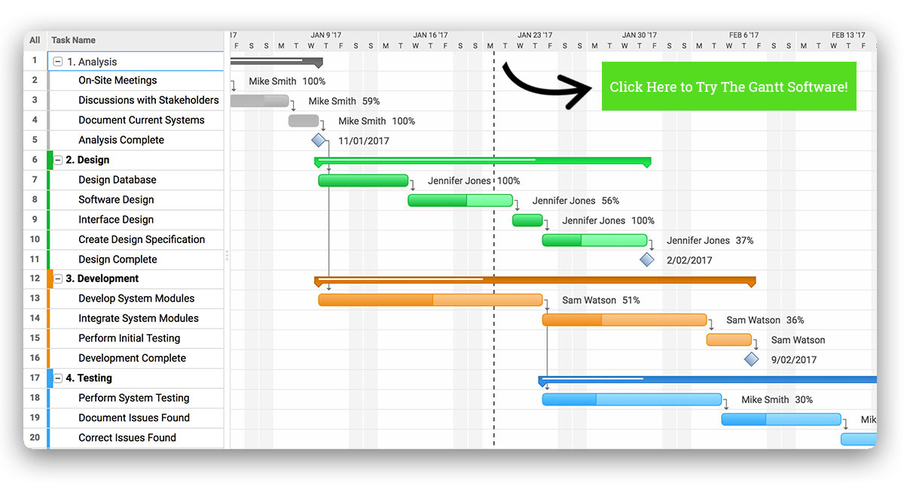
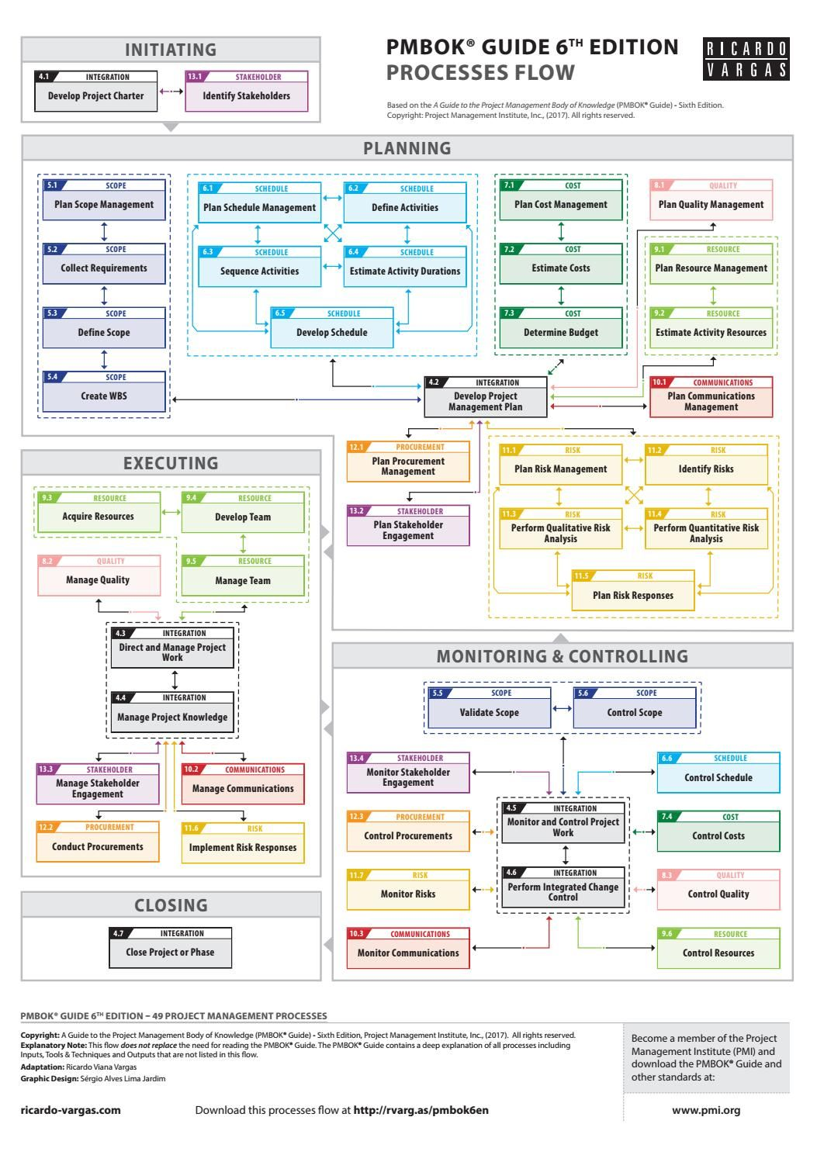
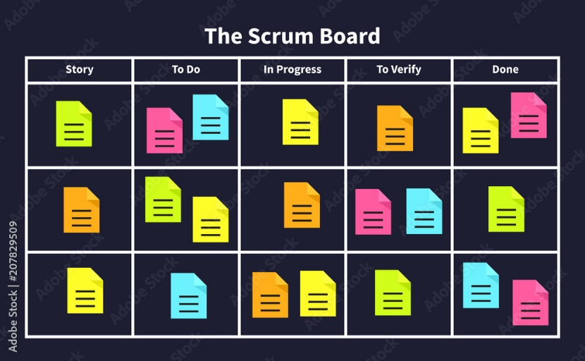
SE Process ⎯ Activities Exemplified Project Management
PMBok
Courtesy https://www.projectmanager.com/gantt-chart
Gantt Chart
Agile-based task board

Slide 30
SE Process ⎯ techniques
Example
Collecting user requirements
Designing software
Coding/Implementation
Testing
Deploying the software at user sites
Maintain software
Configuration Management
Project Management
Use cases/user stories/use case diagram/meeting
UML/ patterns/ principles/ tactics
Java / C++ /framework/platform
Unit test framework/debugger / …
Standalone software/Software plug-in/app/web services/…
Bug reporting/software repository
Version control/change management software
Work breakdown structure/ task scheduling algorithm

Slide 31
SE Process ⎯ deliverables
Example
Use cases / user stories / use case diagram
UML/ patterns/ principles/…
Java / C++/…
Unit testing / debugger /…
Software plug-in/applet architecture
Bug reporting/software repository
Version control / change management software
Work breakdown structure/ task scheduling algorithm
Requirement document
Software design document
Code listing and test script
Quality assurance (QA) report
Software at user site
Bug report and s/w release
Code change / patch / change history report
Project schedule and status tracking

Slide 32
SE Process ⎯ tools
Example
Use cases / user stories / use case diagram
UML/ patterns/ principles/…
Java / C++/…
Unit testing / debugger /…
Software plug-in/app/web services
Bug reporting/software repository
Version control / change management software
Work breakdown structure/ task scheduling algorithm
UML tool / Requirement modeling tool / Word
UML tool / SonarQube
Visual Studio/Eclipse
JUnit/ debugger /fuzzer …
Installer/plug-in framework
Bug reporting system
Apache subversion / git
MS Project/Scrum tool

Slide 33
SE Process ⎯ Best Practices
Different ordering of activities defines different types of software processes
E.g., [see the details in the next few slides]
Waterfall model
V-shape waterfall model
Incremental software development model
Prototyping
Spiral model
Unified Process (UP)
Agile Methods
Hybrid of Agile Methods with Waterfall
AI+, DevSecOps, data-driven
1960s
1980s
2000s
2010s
2024

Slide 34
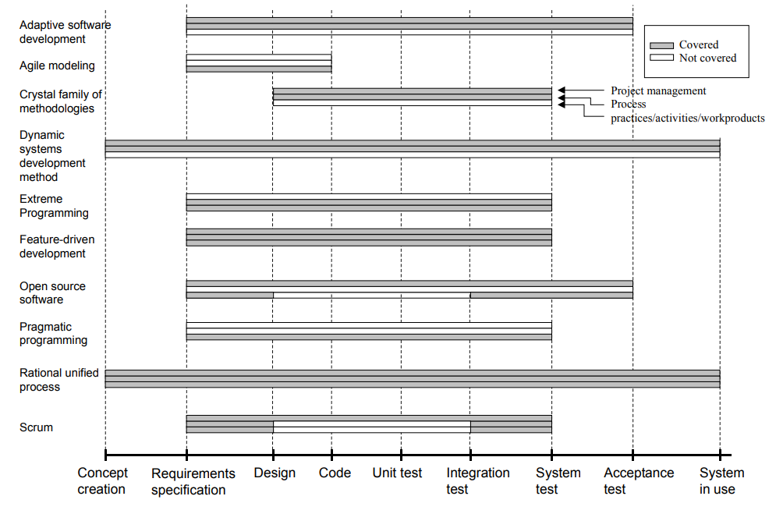
Many Kinds of Agile Methods
All 10 are agile methods.

Slide 35
1-Minute Q&A
Question 1: On the last slide, which agile methods include the project management activities?
Hint: If an agile method requires fewer specific tools, activities, process steps, and intermediate products, then the agile method is more lightweight.
Question 2: Are there any agile methods, both lightweight and including project management activities? Name them
Notes:
Answer to Q1: Adaptive software development, crystal, dynamic system development, feature-driven development, open-source development, RUP, Scrum
Answer to Q2: open-source development and Scrum

Slide 36
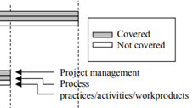
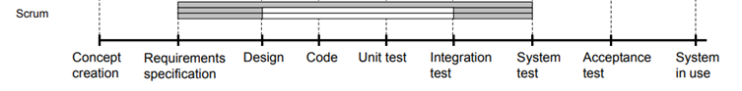
Extreme Programming vs Scrum
XP has no PM.
Scum has PM (but a less tedious process than XP) and other practices/activities/work products

Slide 37
AI in DevOps
Scan it too: https://about.gitlab.com/blog/gitlab-ai-assisted-features/
AI can be in many forms: ML, NLP, CV, Chatbot, agent
Typical usage from GitLab (https://about.gitlab.com/topics/devops/the-role-of-ai-in-devops):
CI/CD: helps to automate the process of building, testing, and deploying code
Automated test process: automatically run tests on new code
Code suggestion: suggest code while developers are typing
Monitor and alert: monitor systems in real-time, detecting potential issues before they become problems. Generate alerts
Code review: first reviewer, merge review requests
Process improvement: analyze log and data to identify trends
Issue analysis: Anomaly detection, root cause analysis, understanding vulnerabilities (note that no code fix suggestion here)

Slide 38
Brief Look on Process Models

Slide 39

Waterfall Model
Completely produce the full set of deliverables of each activity before starting the next activity.
Requirements
Design
Coding / Implementation
Testing
Deployment
Maintenance
+ Simple workflow
− Need test against design, coding details, requirements at the same time.

Slide 40
Waterfall Method
Sequential
Complete one phase nicely before the start of the next phase.
Detailed documentation
Facilitate everyone comprehensively understanding each phase.
Predictability in cost and timeline
through upfront and high-quality planning
Rigidity and Incompatibility with change
Once confirmed, no change
Late discovery of issues
Unsuitability for undefined projects

Slide 41
V-Shape Waterfall Model
Testing
validation target
validation target
validation target
Deployment
Maintenance
+ Stagewise Validation Goal

Slide 42
Problems of “Waterfall Model” and “V-Shape Waterfall Model”
False sense of clear-cut phases of activities.
E.g., Can we completely work out the actual requirement before we design our software?
It is unrealistic for real-world problems.
It is also very costly to correct the problems made in upstream activities. [see the next slide]
Nothing is done until they are all done
E.g., If we end the project at the design phase, then there is no any code delivered to the project clients, but our clients want to have something executable to help their own business!

Slide 43
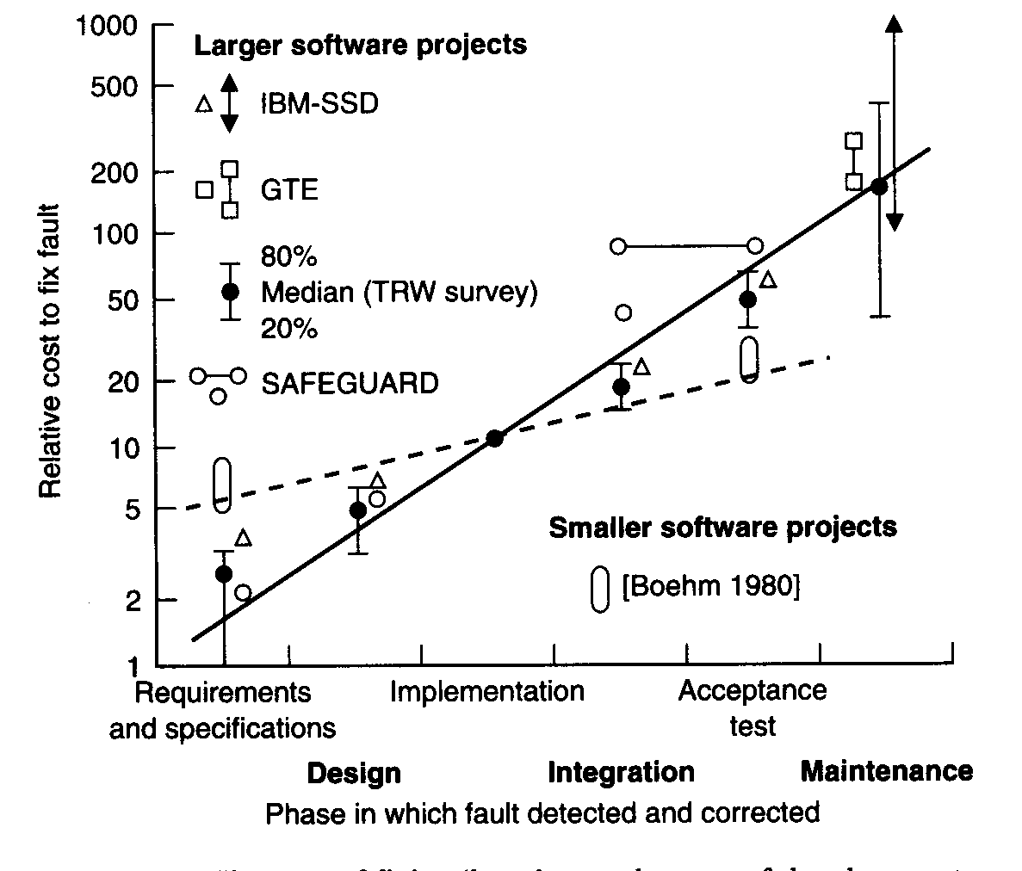
Lesson Learnt: Cost of Fixing Bugs at Earlier Stage is Cheaper
Costly
An artifact that can be validated should be validated as early as possible?
Cheap

Slide 44
Implication on following the Waterfall Model
We would rather have a gracefully degraded subsystem
a partial system, a system of lower quality, instead of no system at the end!
An artifact of an early release subsystem that can be validated should be validated as early as possible? How?

Slide 45
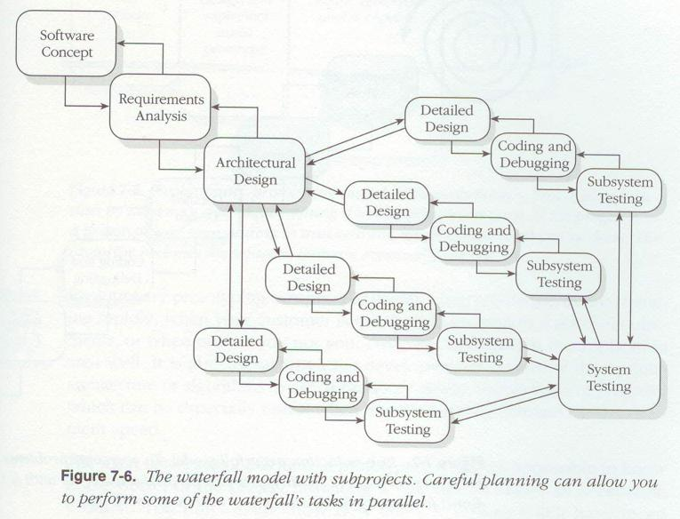
Software Process Improvement Current Trends (1)
Some stages (activities) can be done in parallel
Example: Run technical development and user training in parallel
Development and QA within each parallel track.
Each parallel track fits within a self-contained subsystem.
Quicker for each parallel track to move forward, thereby earlier to rectify bugs ➔ lower cost

Slide 46
Software Process Improvement Current Trends (2)
Backward Iterations
Example:
Requirement
Design
Feedback
Notice the direction of the arrows.
Improve earlier stages whenever necessary
Avoid unnecessary rework or design bugs by working out the more accurate requirements

Slide 47
V-Shape Waterfall Model
Testing
Deployment
Backward transition from
a later phase to an earlier phase.
Maintenance

Slide 48
Prototyping
Prototyping = Code before design and requirement engineering. Incrementally obtain and validate the user/system requirements before a proper software design stage.
Oral Requirements
Coding
Documentation
(Design & Requirement)
Deployment
Maintenance
Testing
A prototype is a preliminary version of the final product: buggy with features partially implemented or only with mockup screens so that users can point out their requirements more easily than expressing them more abstractly.
software prototype released to users
Backward transitions exist but are not shown here for clarity.
Notes:
No additional notes

Slide 49
Incremental Development
Rather than using a parallel track to work on a smaller subsystem, another way is to deliver a smaller set of requirements and gradually enlarge the requirement set.
Divide the set of requirements into subsets.
Implementing one subset to construct a program version v1
then
Implementing another subset on top of v1 to construct version v2
then
Implementing yet another subset on top of v2 to construct version v3
then …
…

Slide 50
Incremental Development
Requirement subset 1
Design 1
Coding / Implementation 1
Testing 1
We may optionally deploy a version to user here!
Requirement subset 2
Design 2
Coding / Implementation 2
Testing 2
Maintenance
Parallel tracks with each stage of each subsystem development is possible
Deployment
….

Slide 51
Spiral Model
Contains characteristics of the waterfall, prototype, and incremental development, but is more systematic.
Basic idea: plan, do prototyping, and revise the previous plans until we know the item X well through a series of iterations.

Slide 52
Step 1) Determine objectives,
alternatives, and constraints
Step 2) Evaluate alternatives,
identify risks, and
resolve risks
Prototype₂
Initial plan
Prototype₁
4
3
2
1
Detailed Design
Requirements,
Development Plan
Design
Code
Unit Test
Step 4) Plan next level
System Test
Acceptance Test
Implementation
Planning
Step 3) Develop,
validate, and verify
next-level
Spiral Software Life Cycle

Slide 53


Software Process Improvement Current Trends
Model-Based Software Engineering Process (various modeling skills as the techniques)
Interact
Developer
Construct
Interact
53

Slide 54
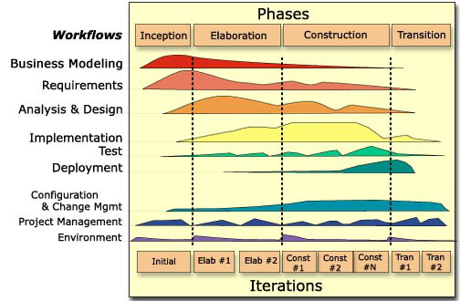
(Rational) Unified Process
weeks
Every type of activity runs in parallel (vertically) with other types of activities in the same iteration.

Slide 55
Ideas of Test-Driven Development
All diagrams are rough sketches to ease communications.
Oral Requirements
Test Script Development
Testing
Deployment
Maintenance
Coding
write automated test case
The minimal functionality of the code that can pass all test cases
+ applying coding principles (or code refactoring) to keep the codebase better organized.
No obvious maintenance phase.
Each iteration must be short in duration in terms of time.

Slide 56
Agile Methods
Iterative development
Deliver works in small increments to users
Customer collaboration
evaluate and feedback on the values of requirements/increments
Response to changes
Continuously evaluate the requirements, plan, and deliver increments with user feedback. Make changes rapidly
Inadequate documentation
Unpredictable delivery time and costs
Dependence on client involvement

Slide 57
Example Agile Method: XP
Extreme programming (XP) has five phases:
Planning
Meet with users, define user stories, and estimate story points. Plan for release through N iterations (for user stories delivery)
Design
Use Simple and consistent design sketch
Coding
Apply XP practice (see the next two slides)
Testing
Conduct automated unit tests and acceptance tests per user story
Feedback
PM and users determine the values of the user stories delivered by the implementation

Slide 58
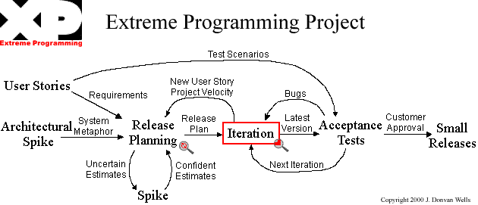

Extreme Programming XP [an Agile Method]
Emphases:
Generate feedbacks
Embrace changes
keep customers engaged
short iteration
Fix bugs early
XP practices
Notes:
See the slides here for references https://www.slideshare.net/bilalhashmishah/extreme-programming-12836919

Slide 59


Extreme Programming XP
http://www.extremeprogramming.org/rules.html
Simple Rules

Slide 60
XP guidelines
Planning: programmers estimate efforts needed for implementing user stories and customer decides the scope and timing of release
Small release: monthly, or daily for small fixes
Metaphor: A shared story guides all developments by describing how the system works
Simple design: use simplest possible solution
Testing: use tests are implemented before the code. Customer write the functional tests.
Refactoring: do refactoring frequently
Pair programming: two people write code at one computer.
Collective ownership: anyone can change any part of the code at anytime
Continuous integration: integrate the code to the project codebase as soon as it is ready.
On-side customer: customers are available full-time
Coding standards: apply them.
Open worksplace: a large room with small cubicles preferred
40-hour week: No Overtime in two consecutive weeks
Just rules: Team has its own but changeable rules for all to follow

Slide 61
Popular PM elements in Agile Methods
Estimate the story point for each user story
Allocate extra time for research on a user story with high uncertainty
Pick a set of user stories into the next iteration in XP (equivalent to the next sprint in Scrum)
Within a cycle (an XP iteration or a Scrum sprint), conduct (daily) standing meetings
A super short meeting (15 mins in total)
[3 mins] Every team member reports
(1) what was done yesterday,
(2) what will be done today, and
(3) what blockers are encountered. For this item, other teammates may help resolve it.
Measure project velocity
At the end of each cycle, conduct a review (a demo to users about the deliverable achieved in the cycle) and a self-reflection on the cycle

Slide 62
User story
A user story is in the following format:
As a <role>, I want an <action>, so that I can achieve a <goal>.
role is what we can identify from Requirements Engineering
action should be tangible (actionable)
goal should be measurable and quantifiable
A user story usually has more information such as use cases, diagram sketch, user notes, data, reports from existing systems to clarify the context and scope of the user story.
E.g., (for AIMS): As a CityU Student, I want to download a testimonial for my student status by submitting a request in AIMS so that I can apply for my student visa extension through the HKSAR Immigration Department.

Slide 63
Relative Story Point Estimation
It is difficult to estimate whether bar A is long and how long bar A is.
However, it would be easier to say that A is longer than B.
A story point is a value.
E.g., Fibonacci sequence: 1, 2, 3, 5, 8, 13, 21, 34, 55, 89, 144, …
E.g., T-shirt size: XXS, XS, S, M, L, XL, XXL
Pick one or more user stories as anchors. The whole team agreed on a story point for each such user story to indicate the number of expected efforts to implement the user stories, taking into account uncertainty and implementation complexity.
E.g., if B is agreed to as 3 story points, and the team has the impression that A is bigger than B but not very much, A can be assigned 5 story points.
A
B

Slide 64
Project Velocity
A user story is implemented in a cycle if it passes the cycle review (by users and product owner)
An agile project is organized as a series of cycles (XP iterations or Scrum sprints).
Each cycle implements a set of user stories with assigned story points.
If a user story is too large to fit into a cycle, the user story should be broken down into multiple user stories.
The total story points delivered by the cycle are plotted.
15
Project velocity
If the outstanding number of story points is 100, then the project needs ceiling(100/12) = 9 more cycles to complete
12
11
12
Max: 15 per cycle
Min: 10 per cycle
Avg: 12 per cycle
10
Story points
cycle
1 2 3 4 5

Slide 65

Burndown Chart
Problem! The project cannot make progress gradually
actual progress
Story points
Cycle | Story Points
0 | 160
1 | 150
2 | 138
3 | 127
4 | 112
5 | 100
cycle
Oops! New user stories added to the project or original estimated story points are underestimated
Story points
cycle
Project velocity is the slope over a consecutive series of cycles.

Slide 66

Scheduled versus Actual
When creating a release plan or a plan for a sprint, the project manager needs a schedule.
Consider our course project (must be delivered by the end of Week 13).
Suppose the project starts at Week 2, each cycle being 1 week. The last cycle is to wrap out the project and write a report, prepare a poster or videos, etc.
At the end of Week 7 (5 cycles completed), the project is delayed.
PM needs to take actions after each cycle: e.g., trim off some user stories and request the team to deliver more story points per cycle

Slide 67
Scrum http://en.wikipedia.org/wiki/Scrum_(development)
Is a kind of agile development process
Arguably the most widely used development process nowadays
driven by daily and periodic one-hour meetings
Go through the usage scenarios/stories to identify a slice of the highest priority backlog tasks to be completed by the next iteration (Sprint) agreed upon by the customer
Together with customers, discuss the goal of the current Sprint, prioritize functions to be completed, and divide into detailed tasks
Conduct periodic short planning and review meetings for tasks completed and not completed in time and revise the set of backlog tasks accordingly
Customers may change their mind at any time
Accept that the requirements cannot be fully understood or defined,
Focus on maximizing the team’s ability to deliver quickly and respond to the selected backlog tasks.
Watch this video: https://tw.voicetube.com/videos/49552 (ignore the ads)

Slide 68

Scrum
Task board
A product backlog = user stories and development tasks due to the completion of some user stories (e.g., bugs found in a later cycle)
Priority the product backlog
Suppose a cycle = two weeks (so, our project has six sprints at most)
A high-priority subset of the product backlog is treated as the current sprint backlog
The size of the sprint backlog is determined by the total number of story points that the team can be delivered within a cycle based on the history
Through the standing meeting, each team member picks an item from the sprint backlog. The target is to deliver the user story in the cycle. (Visualize as a task board)
The tasks needed to deliver the story when it is started are all placed into the “to-do” column of the task board.
When a task is being worked on, it is moved to the “in-progress” column.
When the implementation of the task is completed, it is moved to the “to verify” column (which is usually merged with the-progress column)
At the end of a sprint, conduct a sprint review
Product owners/users verify whether the user story is delivered. If ok, then move the task to the “Done” column.
Also, conduct a sprint retrospective (reflect on what has been done right to make progress and what to be improved to reduce or avoid blockers to improve productivity, etc)

Slide 69
Scrum Tools and Meeting https://www.mountaingoatsoftware.com/agile/scrum/scrum-tools
product backlog is a list of features desired for a final product, the bugs to be removed, technical work to set up and maintain development environment and user site, and knowledge (e.g., learn to use a new framework) to acquire by the project.
release burndown chart tracks progress on a project. The chart itself is updated after each sprint. Teams can measure progress in any unit they choose.
sprint backlog is a list of tasks to complete during a sprint. It is updated once a day.
task board is a sheet that every member of the team can use and add to over the course of a sprint, and is a visual representation of every task and what phase of completion it’s in. Usually, task boards include columns for stories, to-dos, work in process, things needing verification and items finished. Some teams also include burndown charts, notes and tests. Hang the board on a wall or digitalize it.
Meeting: The product owner shows up at the sprint planning meeting with the prioritized agile product backlog and describes the top items to the team. The team then determines which items they can complete during the coming sprint. The team then moves items from the product backlog to the sprint backlog. In doing so, they expand each Scrum product backlog item into one or more sprint backlog tasks

Slide 70



Scrum Tools https://www.mountaingoatsoftware.com/agile/scrum/scrum-tools
release burndown chart
https://www.mountaingoatsoftware.com/agile/scrum/scrum-tools/product-backlog/example
sprint backlog
Hours to go to complete the task
task board
hours
102
86
69
33
days
Sum: 102 86 69 33

Slide 71
Scrum Roles
Scrum Master is the team's coach and helps Scrum practitioners achieve their highest level of performance.
This role does not provide day-to-day direction to the team and does not assign tasks to individuals.
In many projects, this role is assumed by the project manager.
Product owner is responsible for prioritizing the backlog during Scrum development.
Scrum development team as a whole.

Slide 72


Comparison among Agile Methods
Extreme Programming
Scrum

Slide 73
Hybrid Method
E.g., “The video game developer used Waterfall to plan and develop assets like characters and initial coding to ensure that the base game would be robust and well-constructed. They switched to Agile when it came to gameplay mechanics, debugging, and post-launch updates. By applying a hybrid approach, Ubisoft successfully launched Assassin’s Creed Valhalla to commercial acclaim in November 2020.”
Source: https://hbr.org/2023/10/its-time-to-end-the-battle-between-waterfall-and-agile

Slide 74
Hybrid Method
Agile PM + Waterfall
Flexibility and structure
Iterative to deliver increments rapidly
Adhere to (requirements) documentation
Phased and iterative
Phased approach for well-defined components
Iterative approach for uncertain ones
Customer involvement and predictability
getting feedback early and often
Applicable when (1) Diverse stakeholder needs, (2) Varied project phases, (3) Uncertain requirements, and (4) high-risk projects with complex project structures

Slide 75
Home Reading
Read the following section of this reference: https://arxiv.org/ftp/arxiv/papers/1709/1709.08439.pdf
Section 3.2 Scrum
Read the differences between Scrum Master and Product Owner in Scrum
https://www.yodiz.com/blog/scrum-master-vs-product-owner-differences-in-skills-duties-and-responsibilities-agile-methodology/
Read the examples mentioned in the Hybrid Method
https://hbr.org/2023/10/its-time-to-end-the-battle-between-waterfall-and-agile

Slide 76
References
João M. Fernandes and Sónia M. Sousa. 2010. PlayScrum - A Card Game to Learn the Scrum Agile Method. In Proceedings of the 2010 Second International Conference on Games and Virtual Worlds for Serious Applications (VS-GAMES '10). IEEE Computer Society, Washington, DC, USA, 52-59. DOI: https://doi.org/10.1109/VS-GAMES.2010.24
Include a concise summary of Scrum
Videos on YouTube
https://www.youtube.com/results?search_query=scrum

